Slide 1

Vivekanand Education Society’s Institute Of Technology
Department Of Information Technology
DSA mini Project
A.Y. 2025-26
Sustainability Goal :The project supports SDG 16 by enabling transparent, reliable voting and SDG 9 through sustainable tech integration.
Title:
Domain:E-Governance and Web-Based Application Development
Member: Vedant Gharat
Mentor Name:

Slide 2


Slide 3
Content
Introduction to the Project
Problem Statement
Objectives of the Project
Scope of the Project
Requirements of the System (Hardware, Software)
ER Diagram of the Proposed System
Data Structure & Concepts Used
Algorithm Explanation
Time and Space Complexity
Front End
Implementation
Gantt Chart
13. Test Cases
14.Challenges and Solutions
15. Future Scope
16. Code
17. Output Screenshots
18. Conclusion
19. References (in IEEE Format)

Slide 4
Introduction to Project
r Rates
Hybrid voting system combining C program and web interface
Secure candidate registration and vote casting
Real-time updates and result calculation
Persistent storage using Supabase
User-friendly and scalable design

Slide 5
Problem Statement
Traditional voting systems are manual and error-prone
Purely digital systems may lack integration with legacy programs
Need for a secure and real-time voting platform
Combine C program reliability with modern web technologies
Ensure persistent storage, accurate counting, and transparent results
r Rates

Slide 6
Objectives of the project
Develop a full-stack voting application
Integrate C program for core election logic
Implement a web-based frontend for user interaction
Enable real-time updates using Supabase
Ensure persistent data storage
Provide a responsive and user-friendly UI

Slide 7
Requirements of the system (Hardware, software)
Hardware Requirements
Modern computer/PC with internet connectivity
Minimum 4GB RAM and 100MB free storage
Web browser: Chrome, Firefox, Edge, Safari
Software Requirements
Node.js (v14 or higher)
GCC compiler for C program
Supabase account for database
Express.js framework
HTML5, CSS3, JavaScript for frontend
Operating System: Windows, Mac, or Linux

Slide 8
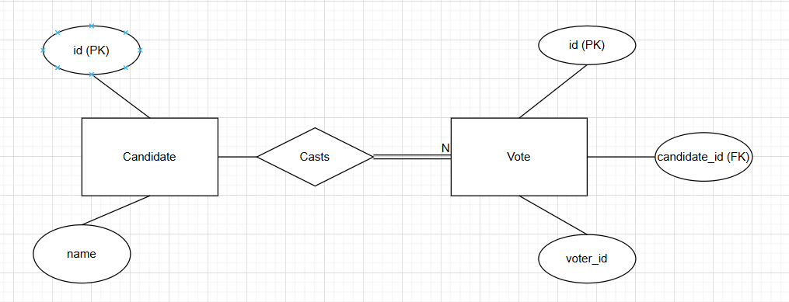
ER diagram of the proposed system

Slide 9
Front End
HTML5: Structure and content of web pages
CSS3: Styling and responsive design for all devices
JavaScript: Client-side logic and form validation
Real-time updates: Dynamic UI changes when votes are cast
User-friendly interface: Easy navigation for candidates and voters
Responsive forms: Candidate registration, vote casting, and results display

Slide 10
Implementation
Backend: Node.js with Express.js server handling API requests
Core Logic: C program for election operations (add candidate, cast vote, find winner)
Database: Supabase for persistent storage of candidates and votes
Integration: Node.js communicates with C program via child processes
Frontend: HTML, CSS, JavaScript for interactive user interface

Slide 11
Gantt Chart
Week | Task
Week 1 | Project planning and setup
Week 2 | Backend development (Node.js + C program integration)
Week 3 | Frontend development (HTML, CSS, JS)
Week 4 | Database integration and real-time features (Supabase)
Week 5 | Testing, debugging, and validation of functionalities
Week 6 | Documentation, report preparation, and final presentation
Notes:
The max flow algorithm in the visualization is :-

Slide 12
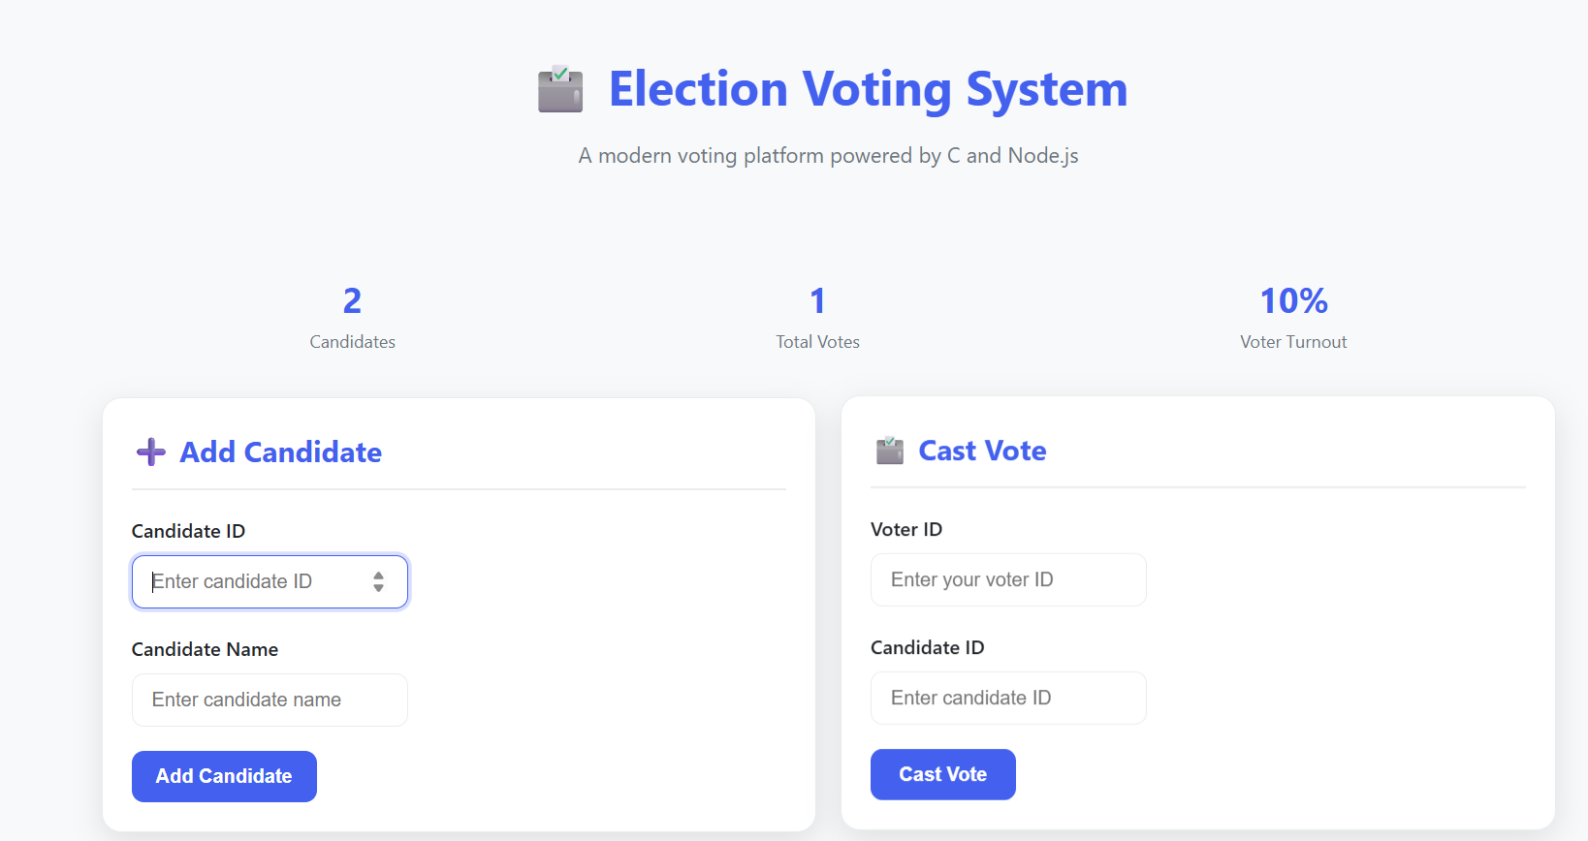
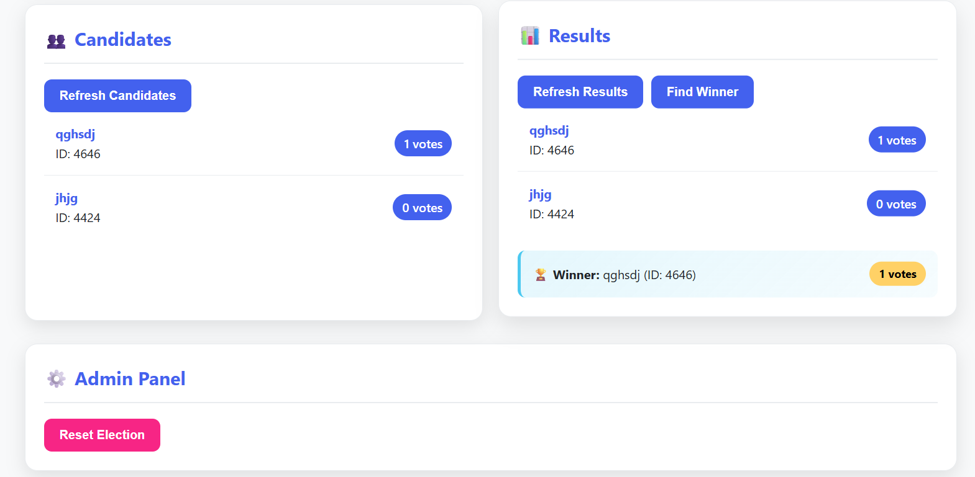
Output Screenshots
Notes:
The max flow algorithm in the visualization is :-

Slide 13
Conclusion
Successfully developed a full-stack hybrid voting system
Demonstrated integration of C program logic with a modern web interface
Implemented real-time updates and persistent data storage using Supabase
Provided a user-friendly, responsive, and scalable platform
Achieved all project objectives with scope for future enhancement

Slide 14
References
Node.js Foundation. (2025). Node.js Documentation. Online. Available: https://nodejs.org/en/docs/
Express.js. (2025). Express Web Framework Documentation. Online. Available: https://expressjs.com/
Supabase. (2025). Supabase Documentation. Online. Available: https://supabase.com/docs
ISO/IEC. (2011). ISO/IEC 9899:2011 Information technology - Programming languages - C. Geneva, Switzerland: ISO.
Mozilla Developer Network. (2025). Web Technologies Documentation. Online. Available: https://developer.mozilla.org/en-US

